Slide 1
Mobile application of
Registration page
PRESENTED BY: SUMANA and HARIPRIYA

Slide 2
Introduction
Student Registration Management (SRM) is a technology for managing all your company’s relationships and interactions with customers and potential customers.
A Student Management System is a software application that keeps track of individual relationships between a student and their activities.

Slide 3
Objective
Goal is simple to improve and understand the student data and interaction.
Helps management to stay connected with the students, streamline processes, and improve data communication.
Notes:
By looking at the complexity and behavior of the data in atrial to enhance performance, judging based on several criteria and trying to explain and evaluate the final results obtained.
This work will go deeply inside trying to provide insights about, enrich, and aid specialists to draw insightful conclusions about the market different indicators using different data science techniques.

Slide 4
Implementation
Front-end
For this project there is a UI that act as a dynamic webpage. It is used to display the details. ( kotlin extension of java )
Back-end
It uses mysql and php. It retrieves the data to serve https requests.

Slide 5
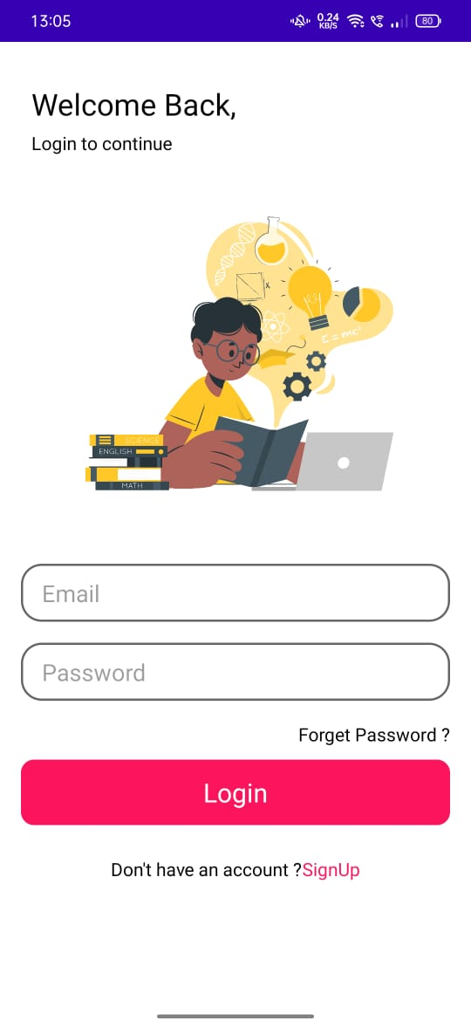
Mobile
view

Slide 6
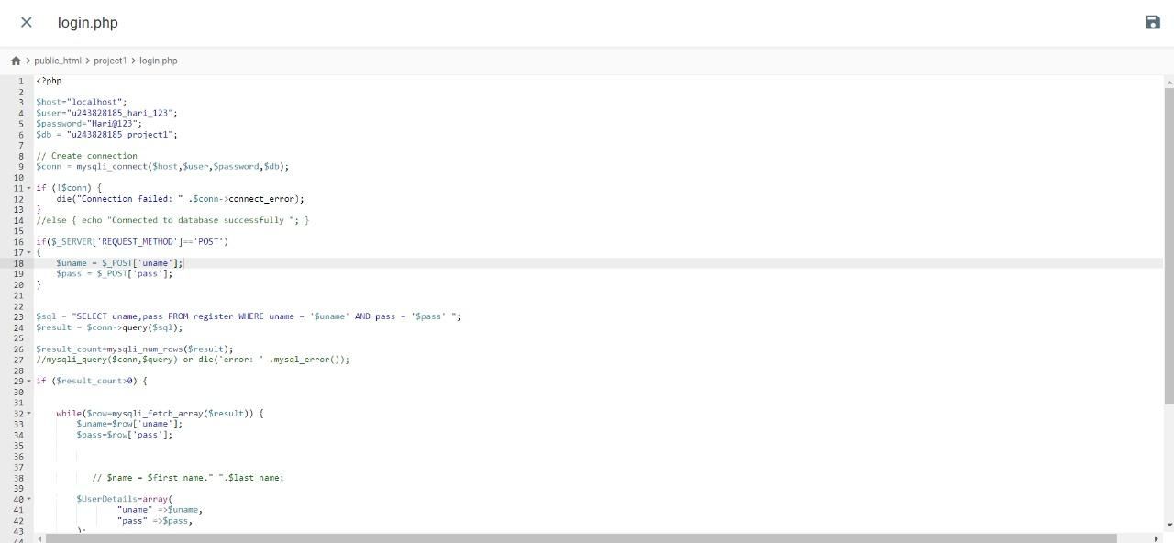

Slide 7
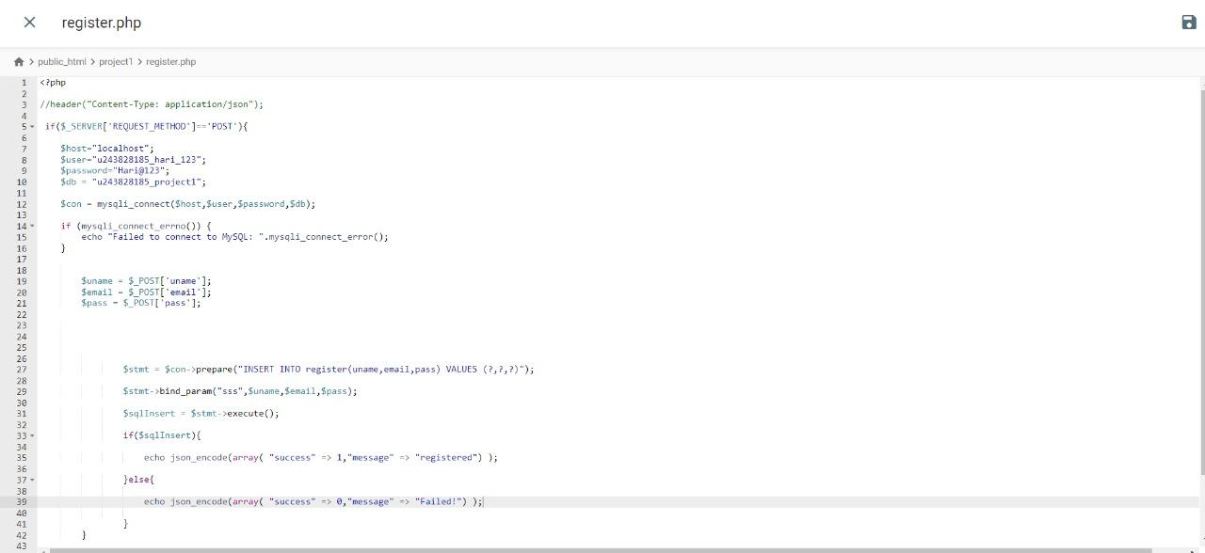

Slide 8
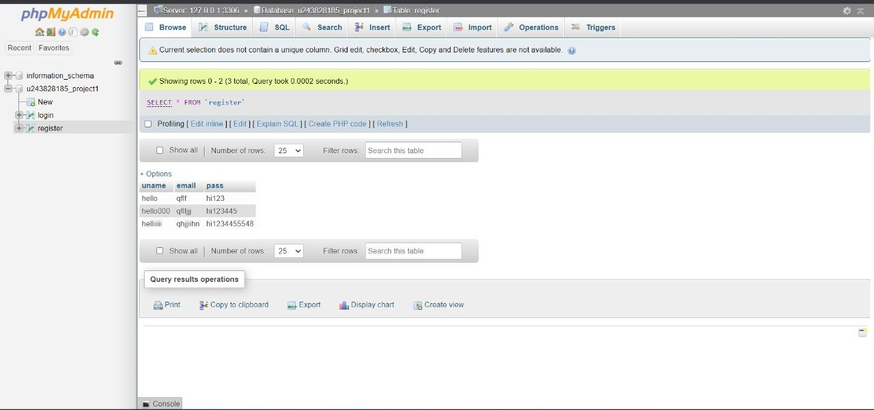

Slide 9
Conclusion
It dynamically integrates the student, email and admin details in order to create and value for the student and its management.
The data in the process to improve performance, grading based on numerous criteria and attempting to explain and interpret the final findings generated.

Slide 10
Thank you

